Slide 1
Lightning Talk: Problems and Users
sdmay25-40

Slide 2
Project Overview
Our project is a novel view synthesis system that uses 3D Gaussian splats with a raytracer that allows for real time dynamic lighting and the incorporation of traditional polygon meshes.
Use a Machine Learning model to extract material properties from videos to allow for dynamic lighting.

Slide 3
Problem Statement
Generate new images of a scene under different lighting conditions with new additional objects from a specific point of view using pictures of the scene from different points of view.

Slide 4
User Type: NeRF
The NeRF User is an individual that Works constantly with 3d models whether its Game related, video related, or commercial related. They Need High quality models and they need them fast so they can pump out their products.

Slide 5
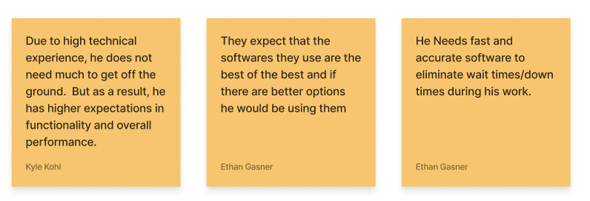
Needs and Expectations: NerF User

Slide 6
User Type: Non-Technical User
This person includes individuals who are not the most technologically advanced who have a need for detailed 3D models but due to their lack of knowledge they choose to use old, poor, and/or outdated methods that they are familiar with. They tend to hate the newer solutions due to their complexity of the current options.

Slide 7
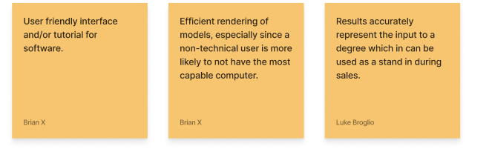
Needs and Expectations: Non-Technical User

Slide 8
User Type: 3D Artist
This user is already familiar with recreating videos or locations in 3D renders either manually or with current tools. They have technical expertise on working with 3D modeling and rendering tools. They would benefit from our solution because it would provide a way to have high quality 3D renders from a video without having to manually recreate or use slower solutions.

Slide 9
Needs and Expectations: 3D Artist

Slide 10
Conclusion
Our product should provide a faster method for dynamic rendering when compared to the traditional NeRFs method, while additionally remaining efficient and as user friendly as possible.
Our product should also produce high quality renders and output them as STL files.

